Slide 1
Why Employees Should Think Like Business Owners
Maximizing Business Value Through Employee Engagement and Financial Wellness

Slide 2
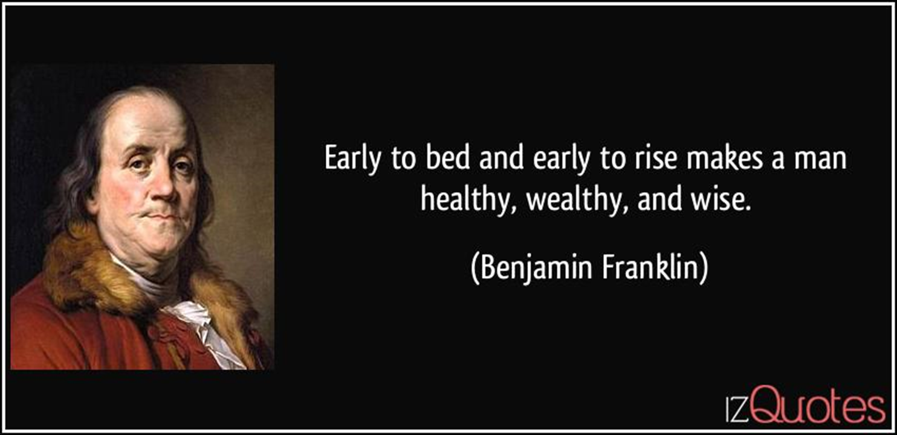
A Famous Man Once Said…
person

Slide 3
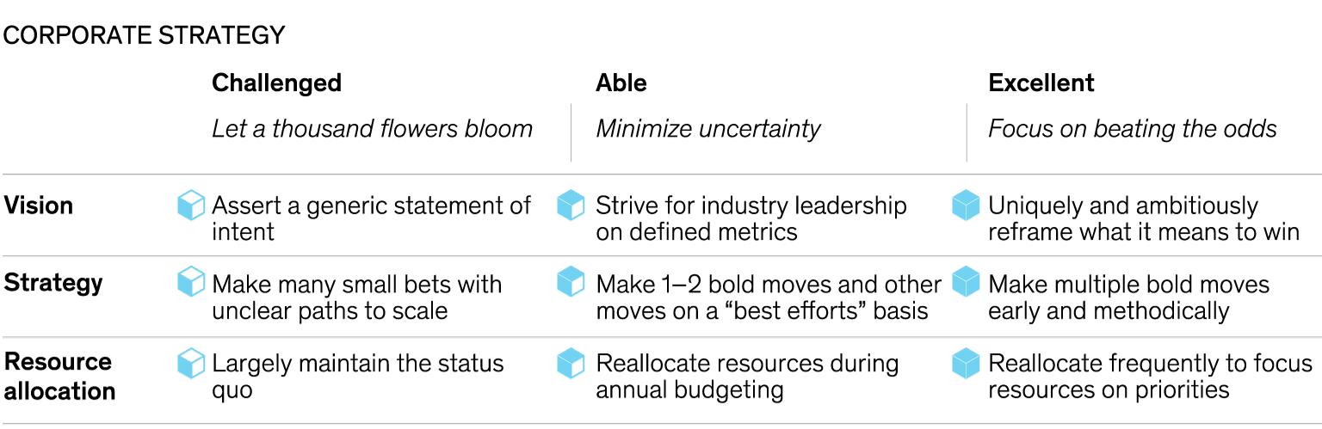
Success Demands More Than Adequate Sleep
Mindsets and practices of excellent CEOs
Successful business owners focus on beating the odds
What are the odds your employees face?
Mindsets and Practices of Excellent CEOs, Mckinsey & Co., 2019
Notes:
90% of new startups fail. 75% of venture-backed startups fail. Under 50% of businesses make it to their fifth year. 33% of startups make it to the 10-year mark.

Slide 4


Financial Stressors Can Have a Large
Impact on Employees
EMPLOYEE FINANCIAL STRESSORS
30% think managing finances is a burden
74% failed a retirement literacy test
Less than 1/2
believe their employer cares about their financial well-being
34% believe financial concerns negatively impact their life, up from 21% 2 years ago
Each employee loses $1,230 annually due
to lack of knowledge about personal finance
GENERATIONAL CONCERN
Rising generations are increasingly worried about Money and Work
Gen Z Adults
(Ages 18-24)
Gen Z Adults
(Ages 18-24)
All U.S. Adults
All U.S. Adults
Sources: Stress in America Generation Z, PwC, 2018; Employee Financial Wellness Survey, PwC, 2018; Cost of Financial Illiteracy in 2018 Study, The National Financial Educators Council, 2019; 2017 RICP® Retirement Income Literacy Report, The American College of Financial Services, 2017; 2018 Expectations & Experiences: Household Finances Study, Fiserv, 2018

Slide 5
Polling Question 1
Does financial stress affect you? Yes/No

Slide 6


How Business Owners Beat the Odds
When contemplating business investments, business owners are methodical and focus resources on priorities
Utilize data-driven research and analysis:
  Future cash-flows
  Capital sources & their costs
  ROI
Respect the risk/reward balance
Seek advice from experts
Engagement and financial wellness are prerequisites for business success. The same is true for your employees.
Notes:
The same is true is for your employees
But don’t worry. Today’s presentation is message of hope because over the course of our time together, I’m going to illustrate how achievable financial wellness is, and it doesn’t require affluence. It does require consistent application of the same principals and behaviors you deploy to run your business.

Slide 7
Helping Employees Beat The Odds
The path to healthier, wealthier and wiser.
WISER

Slide 8

The Path to Wiser
Meet Sara:
22 years old
Recent college graduate
Job: Marketing analyst
Annual Salary: $40,000
Has never seen “Jerry Maguire” so your “Show me the money!” references will always fall flat

Slide 9

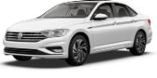
The Path to Wiser
Sara needs a car. She has budgeted $400/month for a car payment.
After market research, she found her ‘best’ finance terms: 3% over 5 years
VW 2020 Passat
$22,000
Car value in 5 years:
$10,500
VW 2020 Jetta
$17,000 ($300/mo)
Common Approach
Beating the Odds
Invests $100/mo (S&P index)
In 5 years, car value:
$8,100
Investment account value:
$7,600
Total: $15,700

Slide 10
The Path to Wiser
Sara’s Strategic Alternatives

Slide 11

The Path to Wiser
Sara’s Strategic Alternatives
Sara has uniquely and ambitiously
reframed what it means to win
Jetta + invested savings
50%
increase
In asset
value!
Notes:
Sara has uniquely and ambitiously reframed what it means to win.

Slide 12
The Lifelong Path to Wiser
Why compound interest is the 8th Wonder of the World
Beating the Odds Long Term
Sara is a millionaire at retirement!
What if Sara keeps saving $100/mo in an S&P index fund?
Sara reallocated resources to focus on her priorities
Based upon average annual return of the S&P over the last 90 years (9.8%)

Slide 13
The Lifelong Path to Wiser
Bold Moves Early and Methodically
What if Sara waits a decade to start saving?
Sara must increase her monthly savings to $255!

Slide 14
Helping Employees Beat The Odds
The path to healthier, wealthier and wiser.
WEALTHIER

Slide 15
The Path to Wealthier
Business owners are uniquely positioned to affect employee outcomes
56%
WHAT EMPLOYEES VALUE IN A COMPANY
Millennials and Gen Xers are more likely to be attracted to a company that cares about their financial wellness
Baby Boomers who have less than $100,000 saved for retirement
39%
Baby Boomers are concerned they will not have enough money in retirement
32%
Gen Xers
Workers are not saving for retirement at all
Source: Employee Financial Wellness Survey, PwC, 2019

Slide 16
The Path to Wealthier
Business owners are uniquely positioned to affect employee outcomes
Leveraging a Qualified Retirement Plan to Improve Outcomes
$1.28MM
At retirement Sara has $255k more without any additional sacrifice
$1.02MM

Slide 17
The Path to Wealthier
Business owners are uniquely positioned to affect employee outcomes
Leveraging a Qualified Retirement Plan to Improve Outcomes
$2.3MM
At retirement, Sara has an additional $1MM without any additional sacrifice!
$1.28MM
$1.02MM
Assumes a 3% employer match
Notes:
729785

Slide 18
Helping Employees Beat The Odds
The path to healthier, wealthier and wiser.
HEALTHIER

Slide 19
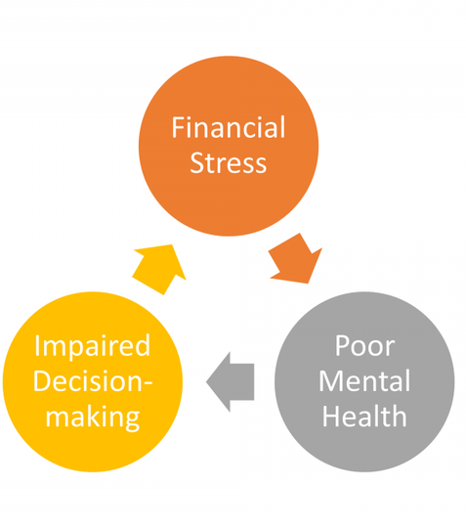
The Path to Healthier
Financial wellbeing has profound effects on mental and physical health
~60%
Say money causes the most stress in their life… more than their personal relationships or job
40%
Say their health has been affected by financial worries
Source: Links Among Financial, Physical And Mental Health, Forbes, 2018
Source: Employee Financial Wellness Survey, 2019, PWC

Slide 20
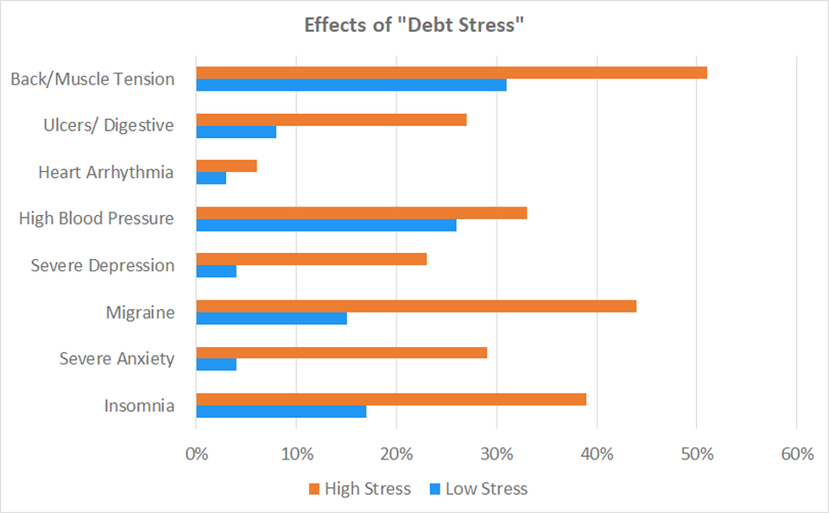
The Path to Healthier
Source: Links Among Financial, Physical And Mental Health, Forbes, 2018

Slide 21
Polling Question 2
What practices do you have in place to help reduce/avoid financial stress?
  Automate Payments - Automatically contribute to your savings - Budgeting Plan - Communicate with your Banker - Manage Your Debt - Manage Investments

Slide 22
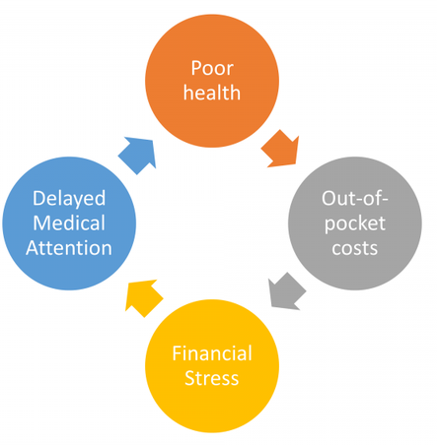
The Path to Healthier
Mental and physical health has profound effects on financial wellbeing
Americans will need on average $400,000 to cover healthcare expenses over the course of a lifetime
Medical bills are reported to be the #1 cause of US bankruptcies, attributing to over 60% of all US personal bankruptcies
31% of all hardship withdrawals from 401(k) are due to medical expenses
Source: David U. Himmelstein, et al. Medical Bankruptcy in the United States, 2007: Results of a National Study
Hardship Withdrawals: Improving the well-being of those who take them. Fidelity Investments, 2019
Source: NHE Factsheet, 2018

Slide 23

The Path to Healthier
Business owners are uniquely positioned to affect employee outcomes
Provide access to the best tax-advantaged savings account available
Save for tomorrow
Build your health care safety net with tax-free money
HSA
Spend for healthcare
Pay for a broad range of
qualified medical expenses
Health
SAVINGS
Account
Invest for the future
Invest in your HSA and save for what’s next
22

Slide 24
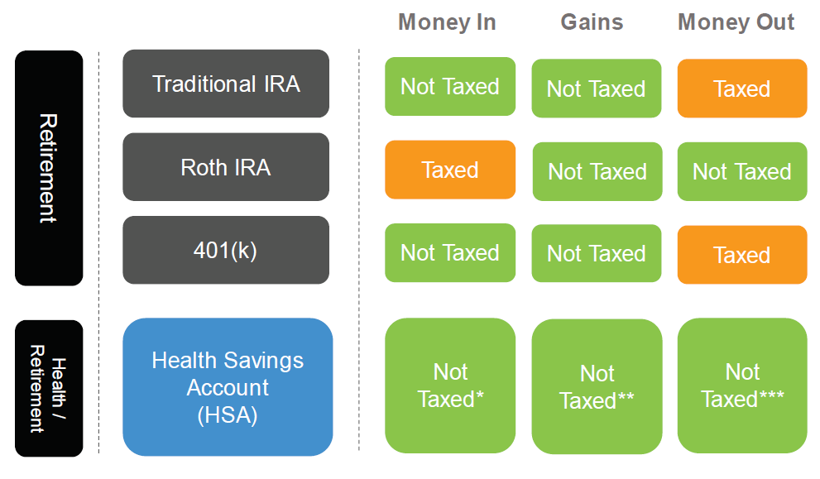
The Path to Healthier
Business owners are uniquely positioned to affect employee outcomes
Provide access to the best tax-advantaged savings account available
23

Slide 25
Business owners are uniquely positioned to affect employee outcomes
Provide access to the best tax-advantaged savings account available
If Sara contributes $3,000 to her HSA this year, she saves:
$750
Federal Tax @ 25%
$217
State Tax @ 7.25%
$230
FICA Tax @ 7.65%
39.9%
$1,197
Total Tax Savings

Slide 26





Helping Employees Beat the Odds
In conclusion
Business owners are uniquely positioned to affect employee outcomes
WISER
WEALTHIER
HEALTHIER
Provide employees access to the financial education they need to:
Uniquely and ambitiously reframe what is means to win
Make bold moves early and methodically
Reallocate resources to focus on priorities
Provide employees access to a qualified retirement savings plan
Match employee savings to incentivize participation and significantly enhance the results
Utilize auto-enrollment to remove friction from the best choices
Provide employees access to a Healthcare Savings Account:
Save for tomorrow – build a healthcare safety net
Spend for healthcare – save ~40%* on a broad range of qualified expenses
Invest for tomorrow – with triple tax deferred savings
Internal Use Only

Slide 27
The Impact of Financial Stress

Slide 28
The Impact of Employee Financial Stress
$500bn COST TO AMERICAN BUSINESSES OF FINANCIALLY STRESSED EMPLOYEES
The problem is getting worse: 34% of workers believe their financial concerns
negatively impact their life, up from 21% 2 years ago
FINANCIAL CONCERNS FOLLOW EMPLOYEES TO WORK
Millennial and Gen Z adults
Spend more than
150 hrs/yr at work thinking about financial stressors
All U.S. adults
49%
60%
Say finances are
a distraction
47%
Admit their productivity has been impacted
26%
Miss work occasionally
10%
Source: The Employer’s Guide to Financial Wellness — 2019, Salary Finance, 2019
Source: Employee Financial Stress, PwC, 2019

Slide 29

The Impact of Employee Financial Stress
Option 1 of 3
(based on listener
demographics)
Financial Wellness Is a Growing Need
HELPING EMPLOYEES & THE BOTTOM LINE: 1,000-EMPLOYEE COMPANY
490
Employees Spend 3+ Hours/Week
on Finances at Work¹
~$15.12
(The Average Skilled Labor Wage)
~67.6k Hours Lost Annually
~$1mm
Lost Annually
x
=
Source: Financial Stress and the Bottom Line, PwC, 2017
Source: Employee Financial Stress, PwC, 2019
Source: Average Skilled Laborer Hourly Pay, payscale.com
1) Calculation: 49% of employees spend 3 or more hours per week at work thinking about financial stressors.

Slide 30
Polling Question 3
Would information and education on how to improve your financial wellness be of interest to you? Yes/No

Slide 31
PNC’s Approach to Financial Wellness

Slide 32
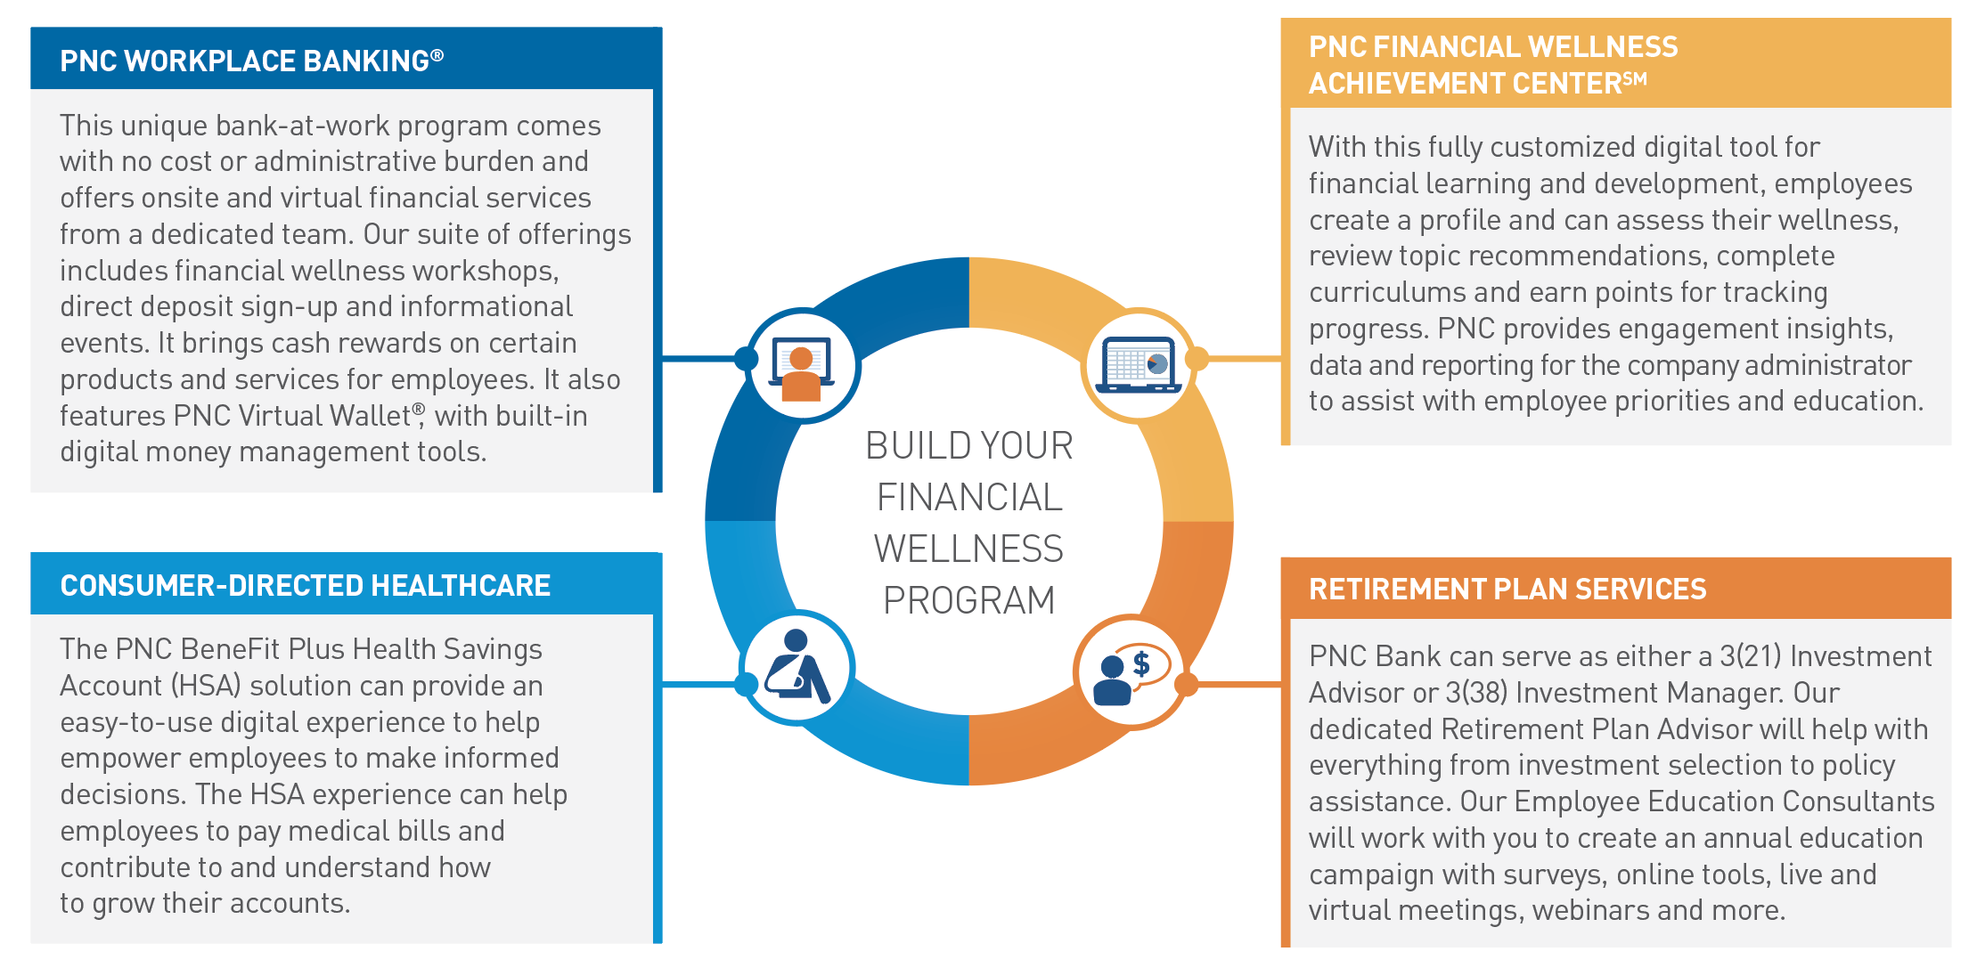
PNC Organizational Financial Wellness
A Customized Financial Wellness Program
BUILD YOUR CUSTOMIZED FINANCIAL WELLNESS PROGRAM, COMBINING INNOVATIVE SERVICE AND SOLUTIONS
PNC collaborates with the human resources decision-maker or dedicated benefits manager to design a custom program for your organization, built with an understanding of your employees’ financial wellness needs. This helps you to deliver the solutions your employees desire and helps them gain financial confidence and security.

Slide 33
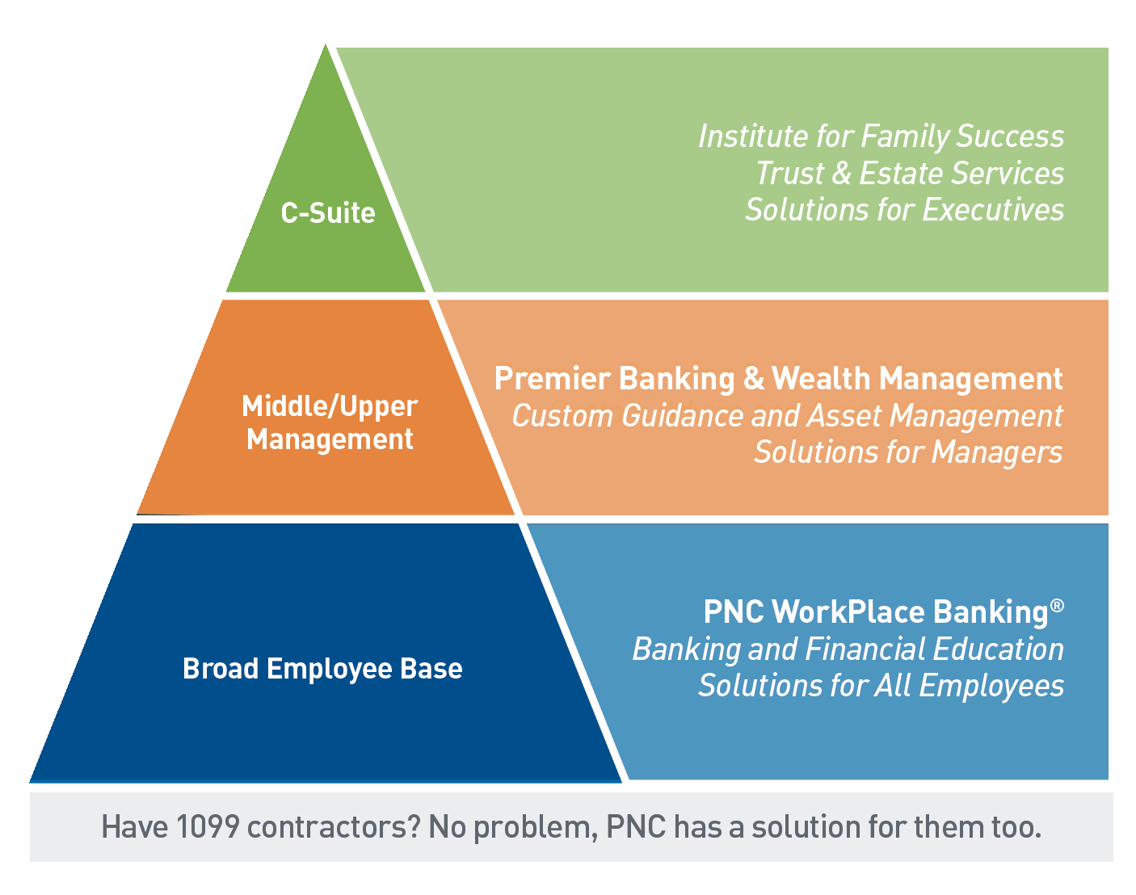
PNC Approach to Financial Wellness
A Solution for Employer and Employees
A dedicated PNC Financial Wellness Consultant collaborates with your HR team on a customized program.
Financial Wellness
Consultant
+
Human Resources
=
Financial Wellness Expertise
Company Knowledge
Employee Needs

Slide 34
PNC Organizational Financial Wellness
Empowering Every Employee to Achieve Their Goals
PNC SOLUTIONS MEET EMPLOYEES WHEREVER THEY ARE ON THEIR FINANCIAL JOURNEY
PNC Serves Every Employee
Broad Employee Base
Middle Management
Senior Executives
Ultra-High-Net-Worth Family Office
Trust & Estate Services
Custom Investment Management
Wealth Strategy
Private Banking
PNC Retirement Plan Services
PNC BeneFit Plus
PNC Virtual Wallet®
PNC WorkPlace Banking®
PNC Financial Wellness Achievement CenterSM
indi Card

Slide 35
Polling Question 4
If info and education to help improve your financial wellness are of interest to you, which topics are you most interested in?
  Retirement - Owning a Home - Credit Scores and Reports - Student Debt Management - Health Savings Accounts

Slide 36
Next Steps

Slide 37
Next Steps
Many of the Organizational Financial Wellness solutions are offered at no cost or administrative burden and can be customized to the needs of your organization. Your dedicated Organizational Financial Wellness Consultant can help you to achieve your goals.
Next Steps
Explore your employee financial wellness needs with your PNC Organizational Financial Wellness representative
Select the solutions from the PNC Organizational Financial Wellness program that align with the needs of your workforce
Work with your PNC Organizational Financial Wellness representative to implement and encourage engagement
Vikki Kertes
Central and Southwest PA Organizational Financial Wellness Market Manager
Vikki.Kertes@pnc.com
216-222-5643

Slide 38
Standard Disclosure
1 To be awarded $100 cash, you must be a PNC WorkPlace Banking participant and make a qualified referral. A referral is qualified if the individual you referred (the “Referee”): 1) is qualified for the PNC WorkPlace Banking program; 2) does not have signing authority on an existing PNC Bank consumer checking account, did not close an account within the past 90 days, and was not paid a promotional premium within the past 12 months; 3) presents the Coupon ID or referral form upon account opening; 4) opens an eligible PNC WorkPlace Banking checking account; and 5) satisfies the specific requirements to earn the monetary reward applicable to their eligible PNC WorkPlace Banking checking account available at the time they open the account. To qualify for the PNC Workplace Banking program’s new customer offer, the Referee must be employed by a company that participates in the PNC WorkPlace Banking program.
$100 cash will be awarded to your account within 60 to 90 days after the monetary reward is issued to the coworker.
The $100 cash award is limited to ten referral payments per year — up to $1,000 per 12-month period. This offer may be extended, modified or withdrawn at any time without prior notice and may vary by market. The value of the reward may be reported on Internal Revenue Service (IRS) Form 1099, and may be considered taxable income to you. Please consult your tax advisor regarding your specific situation.
2 To qualify for the $300 mortgage account reward, at the time of mortgage application the PNC WorkPlace Banking customer must have an eligible PNC WorkPlace Banking Virtual Wallet with Performance Select, Virtual Wallet with Performance Spend, Virtual Wallet Checking Pro, Performance Select Checking account or Performance Checking account, and must establish a qualifying, automatic mortgage payment that must occur within 180 days following the mortgage application. A qualifying, automatic mortgage payment is defined as a recurring PNC Mortgage loan payment electronically deducted from an eligible PNC WorkPlace Banking account. This includes recurring payments set up via Online Bill Pay. Mortgage payments initiated from a PNC Checking account via online transfers do not qualify as automatic payments.
PNC WorkPlace Banking checking account must remain open in order for you to receive the $300 reward, which will be credited to the eligible checking account within 90 days after conditions have been met and will be identified as “CREDITS WORKPLACE MORTG” on your monthly checking account statement. $300 reward may be subject to tax reporting.
Limit one mortgage premium per PNC WorkPlace Banking checking account. If multiple mortgage accounts are opened with the same signer (or signers), only one account will be eligible for the cash offer. For this offer, signing authority will be defined by the customer name(s) and Social Security number(s) registered on the account.
PNC is a registered service mark of The PNC Financial Services Group, Inc. (“PNC”). All loans are provided by PNC Bank, National Association, a subsidiary of PNC, and are subject to credit approval and property appraisal. Terms and conditions of this offer are subject to change without notice.
3 To qualify for the $100 bonus, when applying for a new credit card, the PNC WorkPlace Banking customer must have an eligible PNC WorkPlace Banking Virtual Wallet with Performance Select, Virtual Wallet with Performance Spend, Virtual Wallet Checking Pro, Performance Select Checking account or Performance Checking account, open a new PNC Core, PNC points or PNC Cash Rewards credit card and make at least $1,000 in purchases within the first 90 days following credit card account opening.
The $100 will be in the form of a credit to the eligible checking account provided within 90 days following the purchase that enabled you to meet the $1,000 minimum requirement. The $100 credit will be identified as “CREDITS WORKPLACE CRCARD” on your monthly checking account statement. Your Workplace Banking checking account must remain open in order for you to receive the $100 credit. The $100 credit may be subject to tax reporting. Limit one $100 credit per PNC WorkPlace Banking qualifying checking customer. If multiple credit cards are opened with the same primary borrower, only one credit card account will be eligible for the $100 offer. As used in this offer, the term “purchases” has the same meaning as “qualifying purchase” in the PNC points Program reward terms and conditions, as “purchase” in the PNC Cash Rewards Program reward terms and conditions, or as “purchase” under the account terms for PNC Core. That means that, in general, as used in this offer, “purchases” does not mean all transactions you may make with your credit card account. Some limited transactions, such as cash advance transactions (including the purchase of cash equivalent products) and balance transfers are excluded. Also, fees and interest, even if included in the purchase balance on your account, never earn rewards and are not treated as purchases for purposes of qualifying for the bonus offer.
For details about excluded transactions, please see the complete reward program terms and conditions available on pnc.com/creditcards.
Obtaining a PNC Bank credit card account is subject to credit approval. PNC Bank, National Association, is the creditor and issuer of the credit cards referenced in this offer. For details on reward programs, please refer to the applicable reward terms and conditions, which are available at pnc.com/creditcards. This offer may be modified or discontinued at any time and without notice. Must apply for the credit card at the branch or through a PNC WorkPlace Banker.
PNC Bank, National Association, is the issuer of the PNC Bank credit cards described herein. Bank deposit products and services provided by PNC Bank, National Association, Member FDIC.
Terms and conditions of these offers are subject to change without notice.

Slide 39

Standard Disclosure
Visa is a registered trademark of Visa International Service Association and used under license.
Google Play store is a trademark of Google LLC.
App Store is a service mark of Apple Inc., registered in the U.S. and other countries.
PNC, PNC Bank, PNC WorkPlace Banking, PNC Core, PNC points, PNC Cash Rewards, Virtual Wallet, ACHIEVEMENT, PINACLE, Save Now, Working Cash, ActivePay, Global Trade Excellence, Midland Loan Services, Enterprise!, CMBS Investor Insight, Portfolio Investor Insight, Borrower Insight, Shared Servicing, PNC Riverarch Capital, PNC Erieview Capital, and Solebury Capital are registered marks of The PNC Financial Services Group, Inc. (“PNC”).
Bank deposit, treasury management and lending products and services, foreign exchange and derivative products (including commodity derivatives), and investment and wealth management and fiduciary services, are provided by PNC Bank, National Association (“PNC Bank”), a wholly owned subsidiary of PNC and Member FDIC. Certain fiduciary and agency services are provided by PNC Delaware Trust Company. Equipment financing and leasing products are provided by PNC Equipment Finance, LLC, a wholly owned subsidiary of PNC Bank. Energy financing is provided by PNC Energy Capital LLC, a wholly owned subsidiary of PNC Equipment Finance, LLC. Aircraft financing is provided by PNC Aviation Finance, a division of PNC Equipment Finance, LLC. Asset–based lending is provided by PNC Business Credit, a division of PNC Bank and PNC Financial Services UK Ltd (an indirect wholly owned subsidiary of PNC Bank) in the United Kingdom. Specialty finance products are provided by Steel City Capital Funding, a division of PNC Bank, and specialty finance advisory services are provided by PNC Steel City Advisors, LLC, an SEC-registered investment adviser and a wholly owned subsidiary of PNC Bank. Merchant services are provided by PNC Merchant Services Company. Direct equity investing and mezzanine financing are conducted by PNC Capital Finance, LLC through its PNC Riverarch Capital, PNC Mezzanine Capital and PNC Erieview Capital divisions. Investment banking and capital markets activities are conducted by PNC through its subsidiaries PNC Bank, PNC Capital Markets LLC, Harris Williams LLC, Solebury Capital LLC, and Sixpoint Partners LLC. Services such as public finance investment banking services, securities underwriting, and securities sales and trading are provided by PNC Capital Markets LLC. Mergers & acquisitions advisory and related services are provided by PNC Capital Markets, LLC, Harris Williams LLC, Harris Williams & Co. Ltd., and Harris Williams & Co. Corporate Finance Advisors GmbH. Harris Williams & Co. Ltd is a private limited company incorporated under English law with its registered office at 5th Floor, 6 St Andrew Street, London EC4A 3AE, UK, registered with the Registrar of Companies for England and Wales (registration number 07078852). Harris Williams & Co. Ltd is authorized and regulated by the Financial Conduct Authority. Harris Williams & Co. Corporate Finance Advisors GmbH is registered in the commercial register of the local court of Frankfurt am Main, Germany, under HRB 107540. The registered address is Bockenheimer Landstrasse 33-35, 60325 Frankfurt am Main, Germany (email address: hwgermany@harriswilliams.com). Geschäftsführer/Directors: Jeffery H. Perkins, Paul Poggi. (VAT No. awaited). Harris Williams is a trade name under which Harris Williams LLC, Harris Williams & Co. Ltd, and Harris Williams & Co. Corporate Finance Advisors GmbH conduct business. Equity capital markets advisory and related services are provided by PNC Capital Markets, LLC, Inc., Harris Williams LLC, Harris Williams & Co. Ltd, Harris Williams & Co. Corporate Finance Advisors GmbH, and Solebury Capital LLC. PNC Capital Markets LLC, Harris Williams LLC, Solebury Capital LLC, and Sixpoint Partners LLC are registered broker-dealers and members of FINRA and SIPC. Retail brokerage services and managed account advisory services are offered by PNC Investments LLC, a registered broker-dealer and an SEC-registered investment adviser and member of FINRA and SIPC. Annuities and other insurance products are offered through PNC Insurance Services, LLC. PNC Bank is not registered as a municipal advisor under the Dodd-Frank Wall Street Reform and Consumer Protection Act (“Act”). PNC Bank and certain of its affiliates including PNC TC, LLC, an SEC-registered investment adviser wholly owned by PNC Bank, do business as PNC Real Estate. PNC Real Estate provides commercial real estate financing and related services. Through its Tax Credit Solutions segment, PNC Real Estate provides lending services, equity investments and equity investment services relating to Low Income Housing Tax Credit (“LIHTC”), affordable housing preservation, New Markets Tax Credit (“NMTC”) and Historic Tax Credit (“HTC”) investments. PNC TC, LLC provides investment advisory services to funds sponsored by PNC Real Estate for LIHTC, HTC and affordable housing preservation investments. Registration with the SEC does not imply a certain level of skill or training. This material does not constitute an offer to sell or a solicitation of an offer to buy any investment product. Risks of each fund, as well as information regarding the investments, risks, and expenses of each fund, are described in the fund’s private placement memorandum (PPM) or other offering documents. Please read the PPM and other offering documents carefully before investing.
Important Investor Information – Securities, insurance, foreign exchange, and derivative products are:
Not FDIC Insured • Not Bank Guaranteed • Not A Deposit
Not Insured By Any Federal Government Agency • May Lose Value
In Canada, PNC Bank Canada Branch, the Canadian branch of PNC Bank, provides bank deposit, treasury management, lending (including asset-based lending) and leasing products and services. Deposits with PNC Bank Canada Branch are not insured by the Canada Deposit Insurance Corporation or by the United States Federal Deposit Insurance Corporation.
PNC does not charge a fee for the mobile banking service. However, a supported mobile device is needed to use mobile banking. Also, your wireless carrier may charge you for data usage. Check with your wireless carrier
for details regarding your specific wireless plan and any data usage or text messaging charges that may apply.
Lending, leasing and equity products and services, as well as certain other banking products and services, require credit approval.
PNC does not provide legal, tax or accounting advice unless, with respect to tax advice, PNC Bank has entered into a written tax services agreement.
Banking and lending products and services, bank deposit products and treasury management services for clients and/or customers are provided by PNC Bank, National Association, a wholly-owned subsidiary
of PNC and Member FDIC.
©2020 The PNC Financial Services Group, Inc. All rights reserved.

