Slide 1
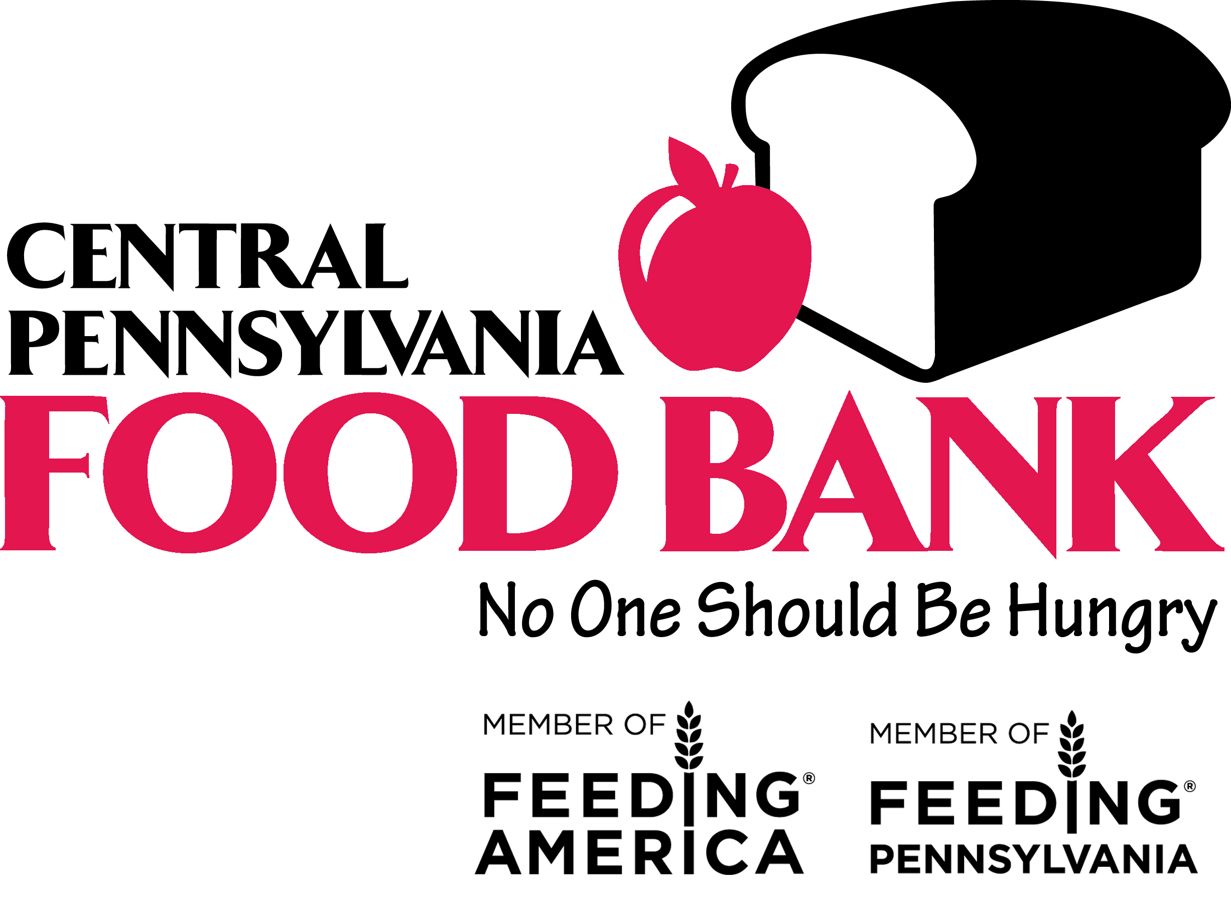
www.centralpafoodbank.org
Notes:
Thank you for inviting the Central Pennsylvania Food Bank to talk with you about our work.
Fighting hunger, improving lives, and strengthening communities is our mission. The Central Pennsylvania Food Bank serves hundreds of thousands of individuals, hardworking families and their children, seniors, and veterans. Everyone deserves access to good, nutritious food -- and enough of it to live healthy, successful lives.
As we continue to talk about the Food Bank, please feel free to ask me questions as we go along.

Slide 2
Joe Arthur Executive Director, Central Pennsylvania Food Bank
Joe Arthur was appointed Executive Director of the Central Pennsylvania Food Bank in 2012, after serving four years as Associate Director. As the Food Bank’s principal ambassador, Joe presents regularly on the issue of hunger in Pennsylvania and nationally. He is a leader in anti-hunger work through his Board engagement for the associations Feeding Pennsylvania, Hunger Free Pennsylvania, Hunger Free Lancaster County, First Fruits Farm, and the Mid-Atlantic Regional Produce Cooperative of food banks. Joe is also a national council representative at the Food Bank’s national affiliate, Feeding America, as well as a member on the Governor’s Food Security Partnership.
www.centralpafoodbank.org

Slide 3
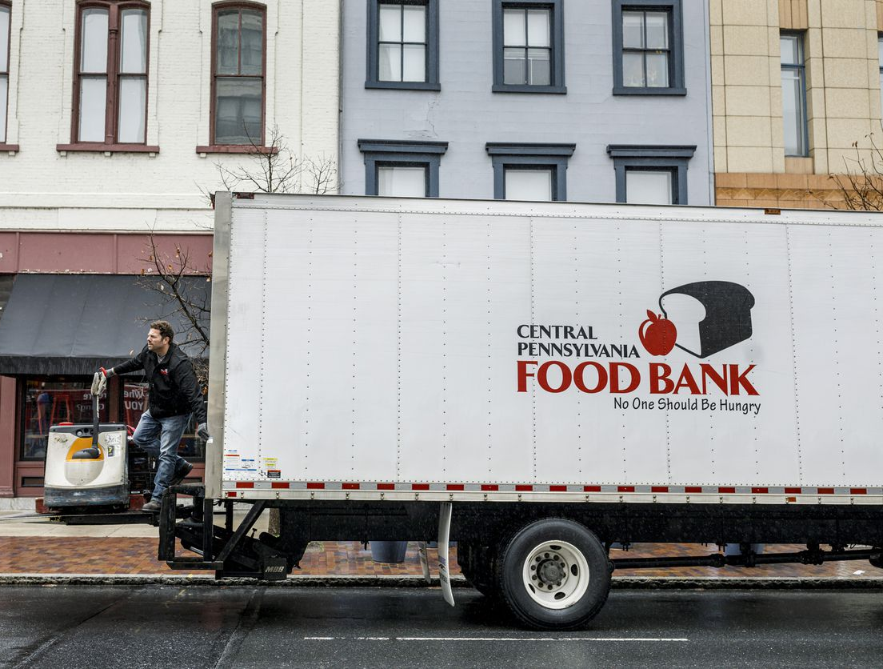
Notes:
We are going to start with a short video on How the Food Bank works.
(Image on slide is linked to https://www.youtube.com/watch?v=41h7J1tfyzU&t=11s)
(If you do not have the option to show a video – slide 4 – then use Slide 5 to go over how the Food Bank works. You can delete Slide 4 or Slide 5 as you see fit, but again remember to save to on to desktop and not save over this master copy.)

Slide 4
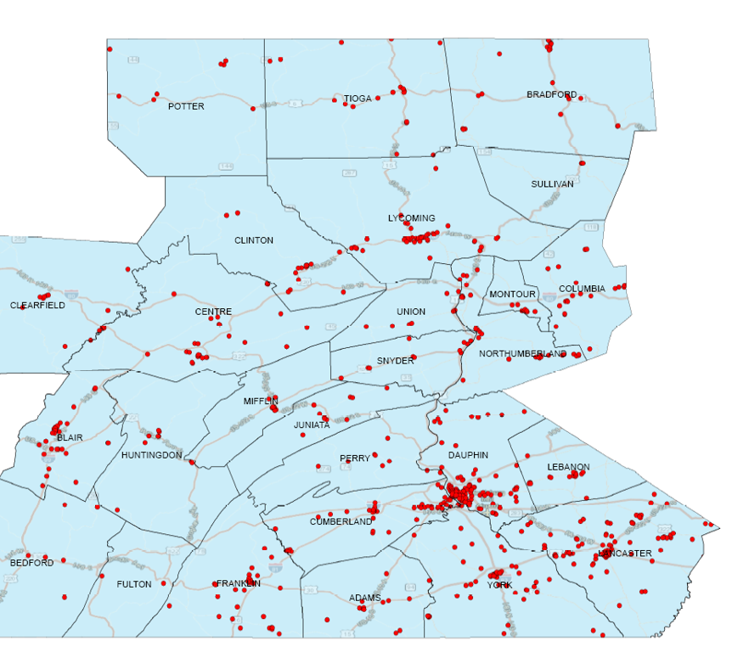
Serving 27 counties
Partnering with a network of over 1,200 partner agencies
www.centralpafoodbank.org
Notes:
The Central Pennsylvania Food Bank serves 27 counties across Pennsylvania - from the border of New York down to the border of Maryland, twice the size of New Jersey. Our territory is wide, but our impact is local by partnering with over 1,200 partner agencies . We are central Pennsylvania’s local Food Bank with two hubs in Harrisburg and Williamsport and have been nourishing the communities in which we serve since 1982.
We are also a member of Feeding America and Feeding Pennsylvania, as we believe strong partnerships are needed to be successful in the fight to end hunger.
To further clarify – allow me to go over a Food Bank vs. Pantry/Partner
A food bank has the capacity to distribute millions of pounds of grocery product every year. The Central Pennsylvania Food Bank acquires, packs, and distributes about a million pounds of food on average per week.
Local food pantries, soup kitchens, senior centers, emergency shelters, schools, VFW’s, and even hospitals are member agency of, and obtains food from, a food bank. They order a variety of items online from us at low cost or no cost at all, our fleet of trucks delivers these items to our partners, and they share the much-needed food with their community.
To sustain our mission of feeding our neighbors in need at the local level, the Food Bank shares its resources to invest in these critical organizations. We support infrastructure like refrigeration, shelving, and trucks. We help the network expand the selection of food items, provide nutrition education, and set up safe distribution methods.

Slide 5
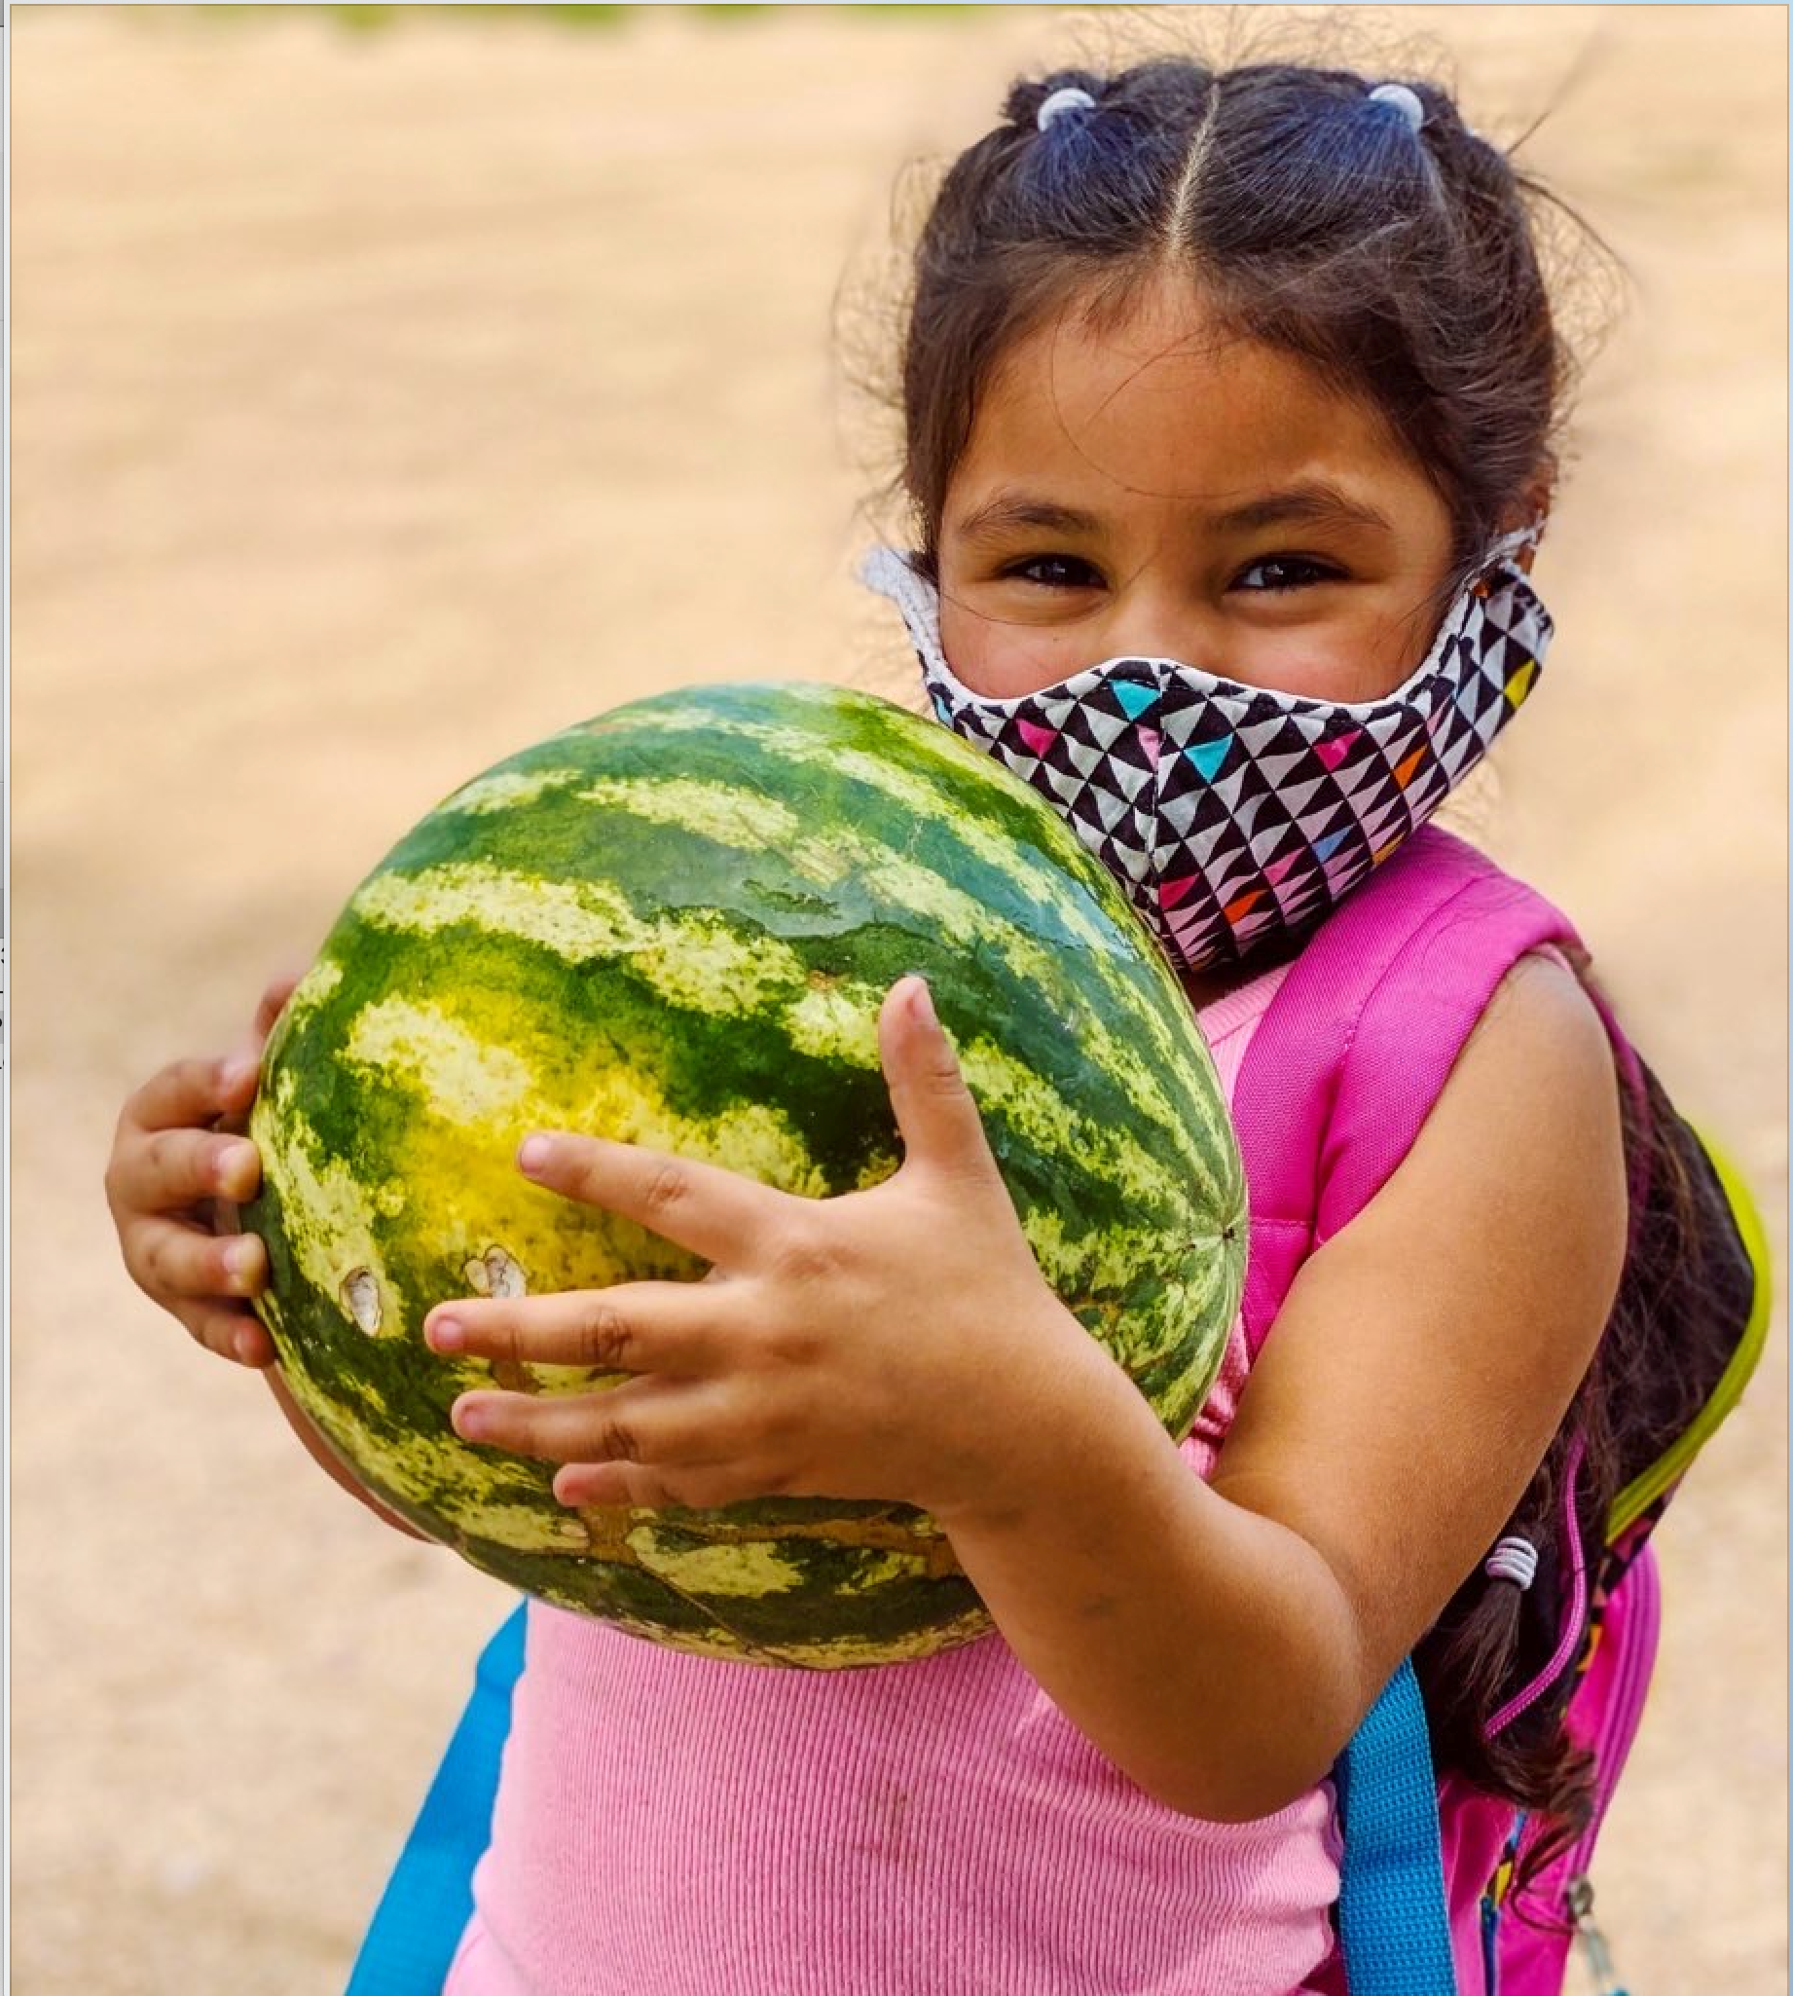
What is food insecurity?
USDA Definition: Food insecurity
A lack of consistent access to enough food for an active, healthy life.
www.centralpafoodbank.org
Notes:
Food insecurity is defined as a lack of consistent access to enough food for an active, healthy life.
The economic consequences of losing a job, or a spouse or partner; facing significant unexpected expenses like medial bills or home repairs, or sometimes a paycheck or fixed income that just doesn’t go far enough is all it takes to make access to good, healthy food and enough of it, out of reach.

Slide 6
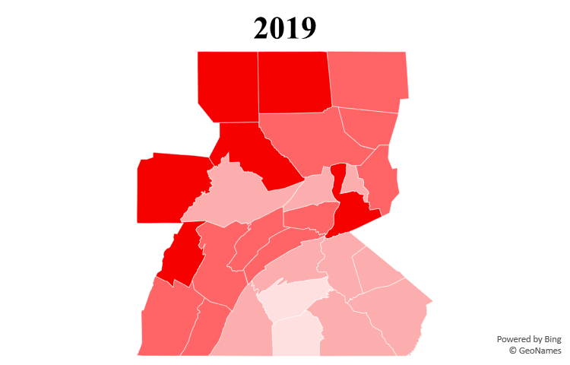
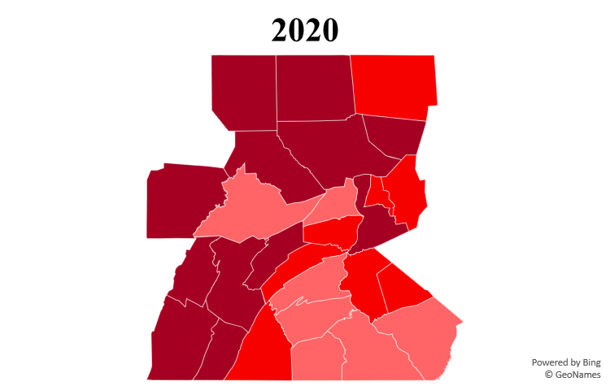
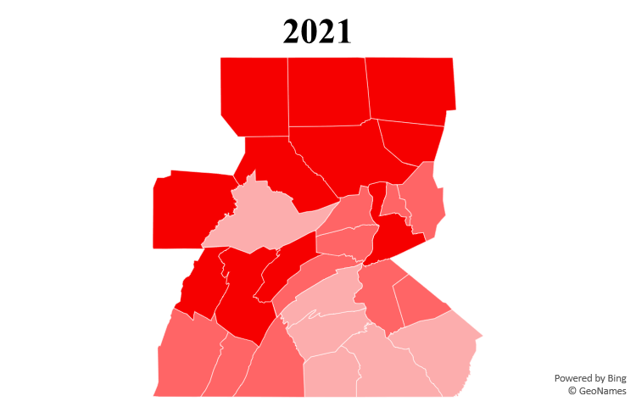
Food Insecurity in Central Pennsylvania
fighting hunger, improving lives, strengthening communities
Notes:
The COVID-19 crisis revealed how vulnerable so many Pennsylvanians are to hunger. Many are just one missed paycheck away from financial hardship. While the signs of economic recovery are encouraging, food insecurity is still a stark reality for thousands of our neighbors. Today, more than 337,000 central Pennsylvanians remain vulnerable to hunger, including 1 in 7 children.
What do we mean by food insecure? Food insecurity is defined as the disruption of food intake or eating patterns because of lack of money and other resources. Food insecurity does not exist in isolation, as it affects multiple, overlapping issues like lack of affordable housing, social isolation, chronic or acute health problems, high medical costs, and low wages.
This page is the snapshot of the need in Central PA over the past 3 years.
Food insecurity remains substantially higher in 2021 relative to 2019; but improving since it peaked during the pandemic in 2020 as shown in the maps.
32,550 people in central Pennsylvania are newly food insecure since 2019 – an 11% increase. Nearly 10,260 children are also food insecure for the first time, an increase of 12% since 2019.
Government aid and the start of economic recovery is helping; in September 2021 there are 53,330 fewer food insecure individuals than in 2020.
Going forward, food insecurity will depend on the pace and spread of the economic recovery and whether key government assistance programs like increased SNAP (Supplemental Nutrition Assistance Program) benefits and the child tax credit expansion continue.

Slide 7
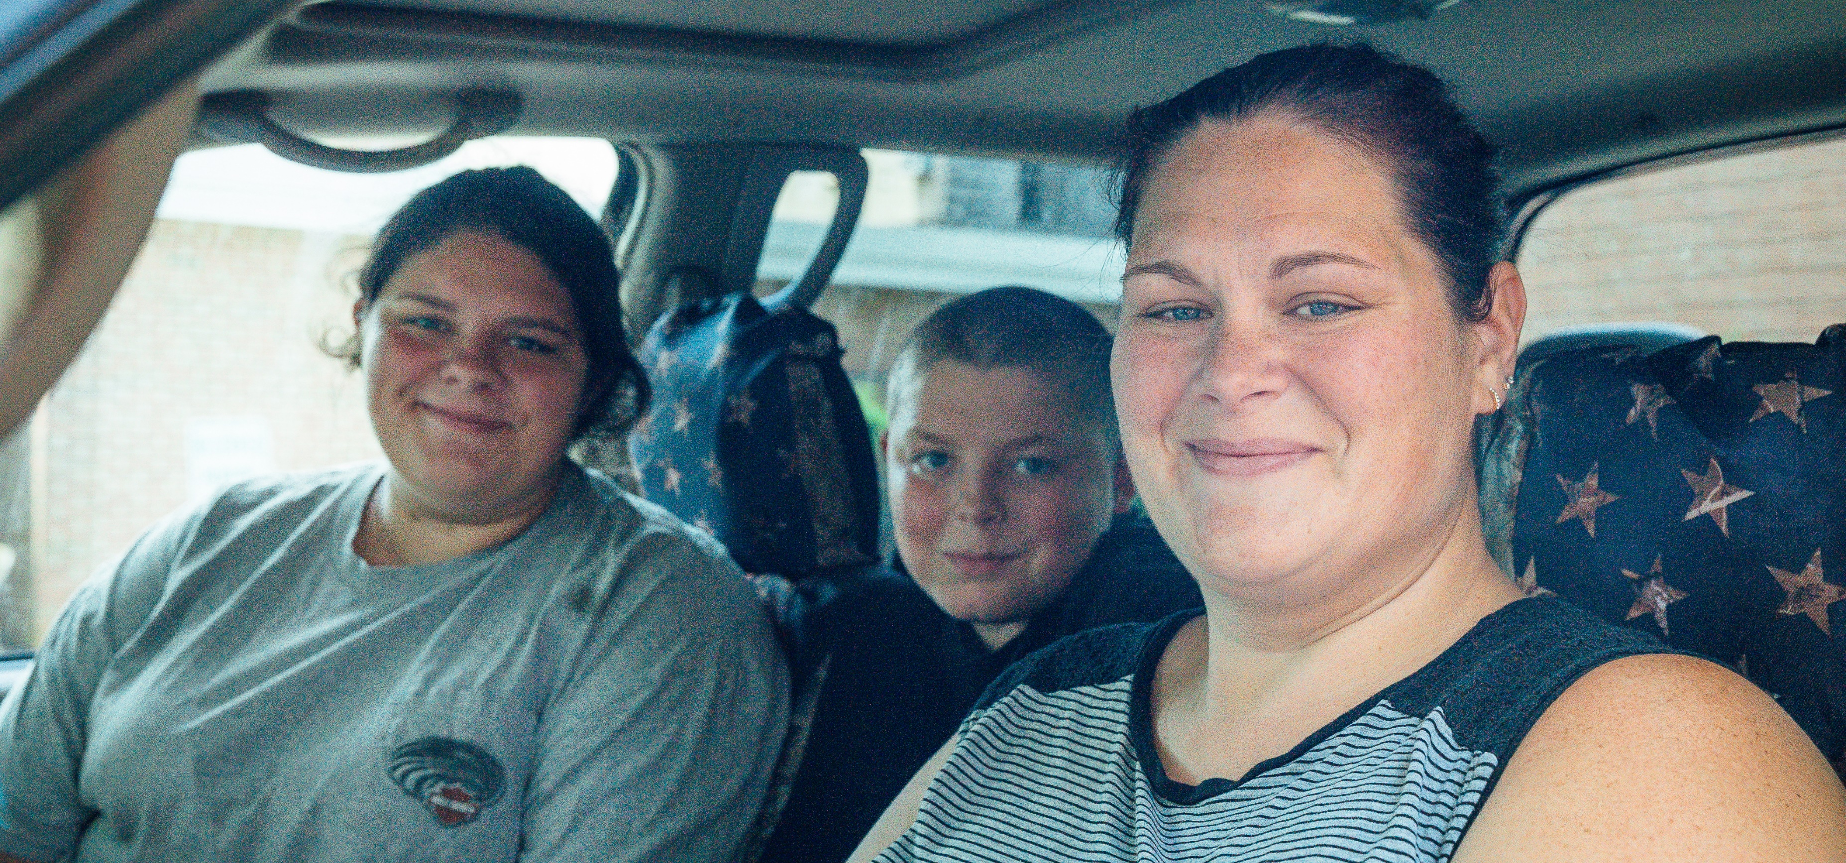
“We have been coming for the past year, every week. You don't realize how much the school meals help until they're home all day and eating 24/7. Being able to provide for my kids is such a comfort.”
Tiffany, Lancaster County
“We went through a tough spot, and we weren’t able to afford food. The Food Bank helped push us farther until we could get the finances to afford food. There was lots of produce, that was our favorite part.”
Austin, Tioga County
www.centralpafoodbank.org
Notes:
Food shouldn’t be an impossible choice. For many, a daily meal is just a choice of what to eat for dinner. For those facing hunger, a daily meal poses a very different type of choice. It is often an impossible choice between food and other critical needs such as utilities, housing, childcare or medicine.
For Tiffany, putting enough food on the table was particularly challenging this past year due to COVID. The children completing their schooling from home meant that school-funded meals were no longer an option. She turned to the Food Bank and our local partner’s food distribution, which she sees as a “huge blessing.”
Austin and his wife were expecting their first child when Austin lost his job as a butcher in 2020 due to COVID. The couple suddenly faced anxiety over how they were going to get money to purchase necessary items for their baby, plus have enough food. To get the food they needed, they reached out to their local food pantry, a partner of the Food Bank. One year later, Austin’s wife has found a new job, while Austin continues to apply. They’ve been able to save money and get back on their feet. They haven’t needed the services of the Food Bank for several months.
This past year we learned just how strong we can be together - even when we couldn’t be together! Because of donors, volunteers, our network of partners and tireless team, we gave hope through the healing power of healthy food to our neighbors in need, many who needed help for the first time.

Slide 8
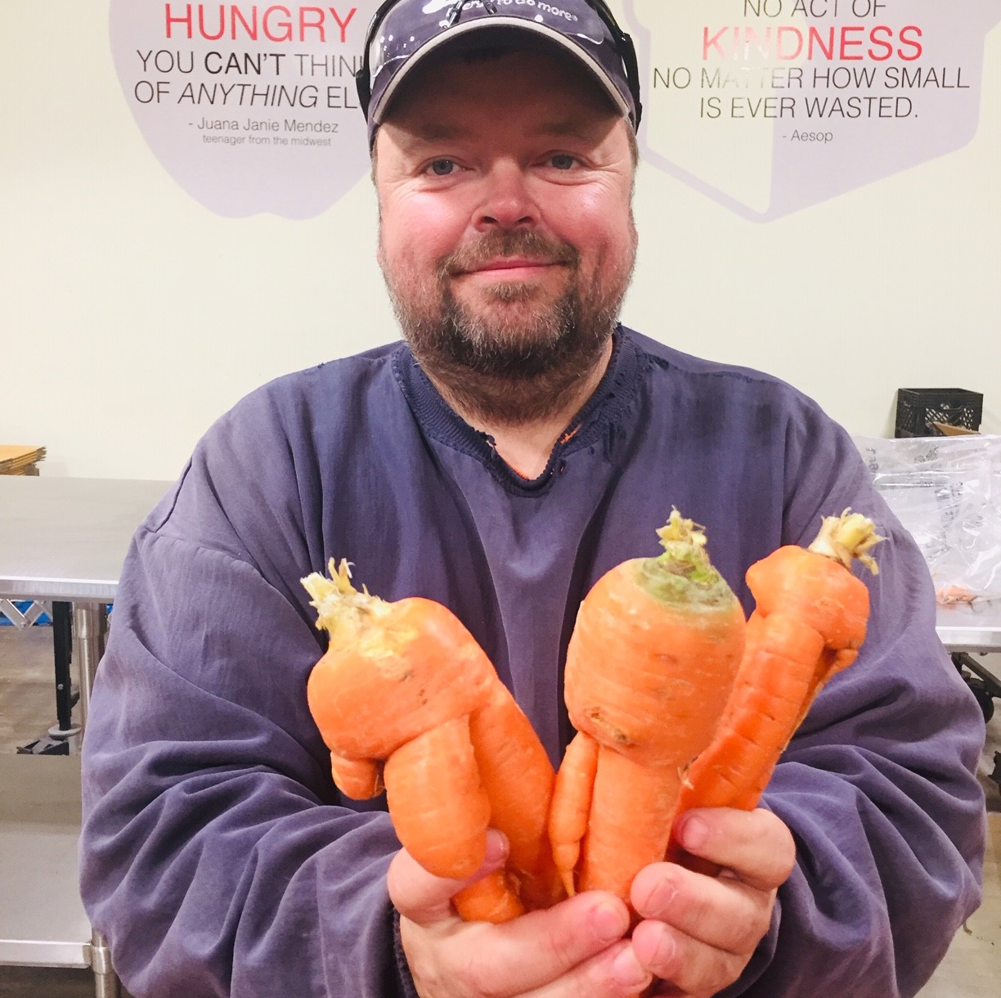
Acquiring
Fresh Food
Last year we:
Rescued nearly 32 million pounds of food!
Distributed nearly 14.5 million pounds of produce.
Distributed 6 million servings of fresh milk.
www.centralpafoodbank.org
Notes:
The Food Bank has a long-standing wonderful partnership with the agriculture community, both local and country wide. Each year we rescue millions of pounds of fresh fruits and vegetables, healthy proteins, and dairy from local farmers, keeping it from the landfill and putting it on the tables of those who need it the most.
We are also making a wider variety of foods available that appeal to varied cultural preferences. There is dignity in having access to food that tastes good, respects culture, AND is good for you.
The Central Pennsylvania Food Bank has annual and seasonal food donation programs.
Pennsylvania Agriculture Surplus System (PASS) – PA Department of Agriculture provides funding to offset the costs to rescue wholesome food and share it with those in need. We work with farmers to receive produce that may have not met retail standards and would have been plowed under. The Food Bank and the farmer receive money from this program to rescue this food. For example, PASS funding was used to secure 30 tanker trucks of surplus milk that was going to be dumped to be processed into cheese for those in need across Pennsylvania.
Mid-Atlantic Regional Coop (MARC) – in collaboration with other regional Food Banks on the east coast, we bid on surplus produce and fruits from the mid-atlantic farms and the Port of Philadelphia at deep discounted rates. This means fruit and veggies in the wintertime when our growing season has ended!
Farm to Agency Resource Market (FARM) Grants - The FARM Grant program is a new initiative to support both partners and food producers to capture even more fresh fruits, vegetables, dairy, and protein. It will match sources of fresh-from-the-farm commodities, especially smaller growers and farmers markets, with pantries, soup kitchens, and shelters within just a few miles. The food will be shared locally; it won’t need to pass through the Food Bank’s hubs. It is hyper-local, hyper-fresh, and very healthy.

Slide 9
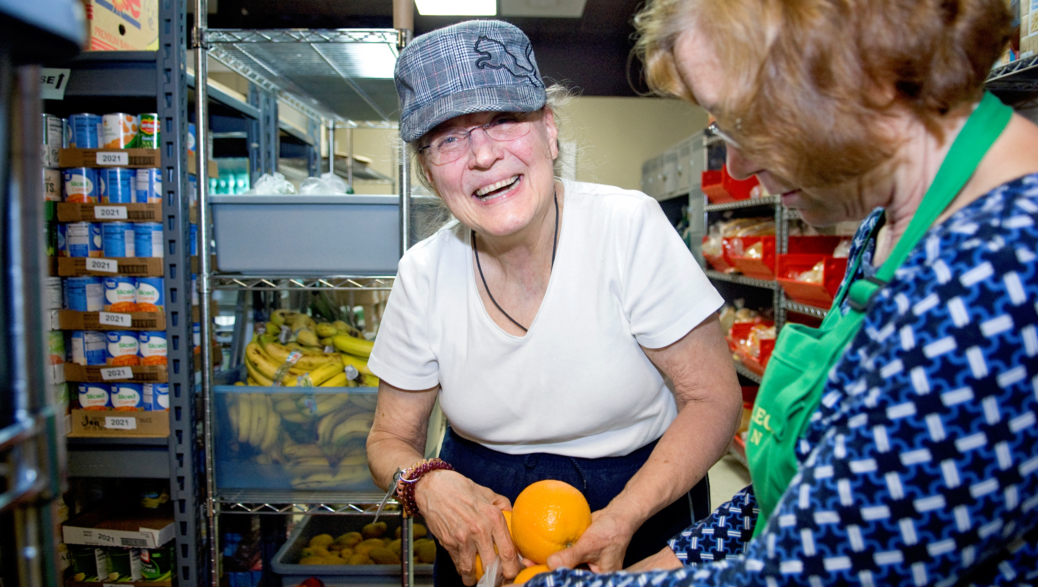
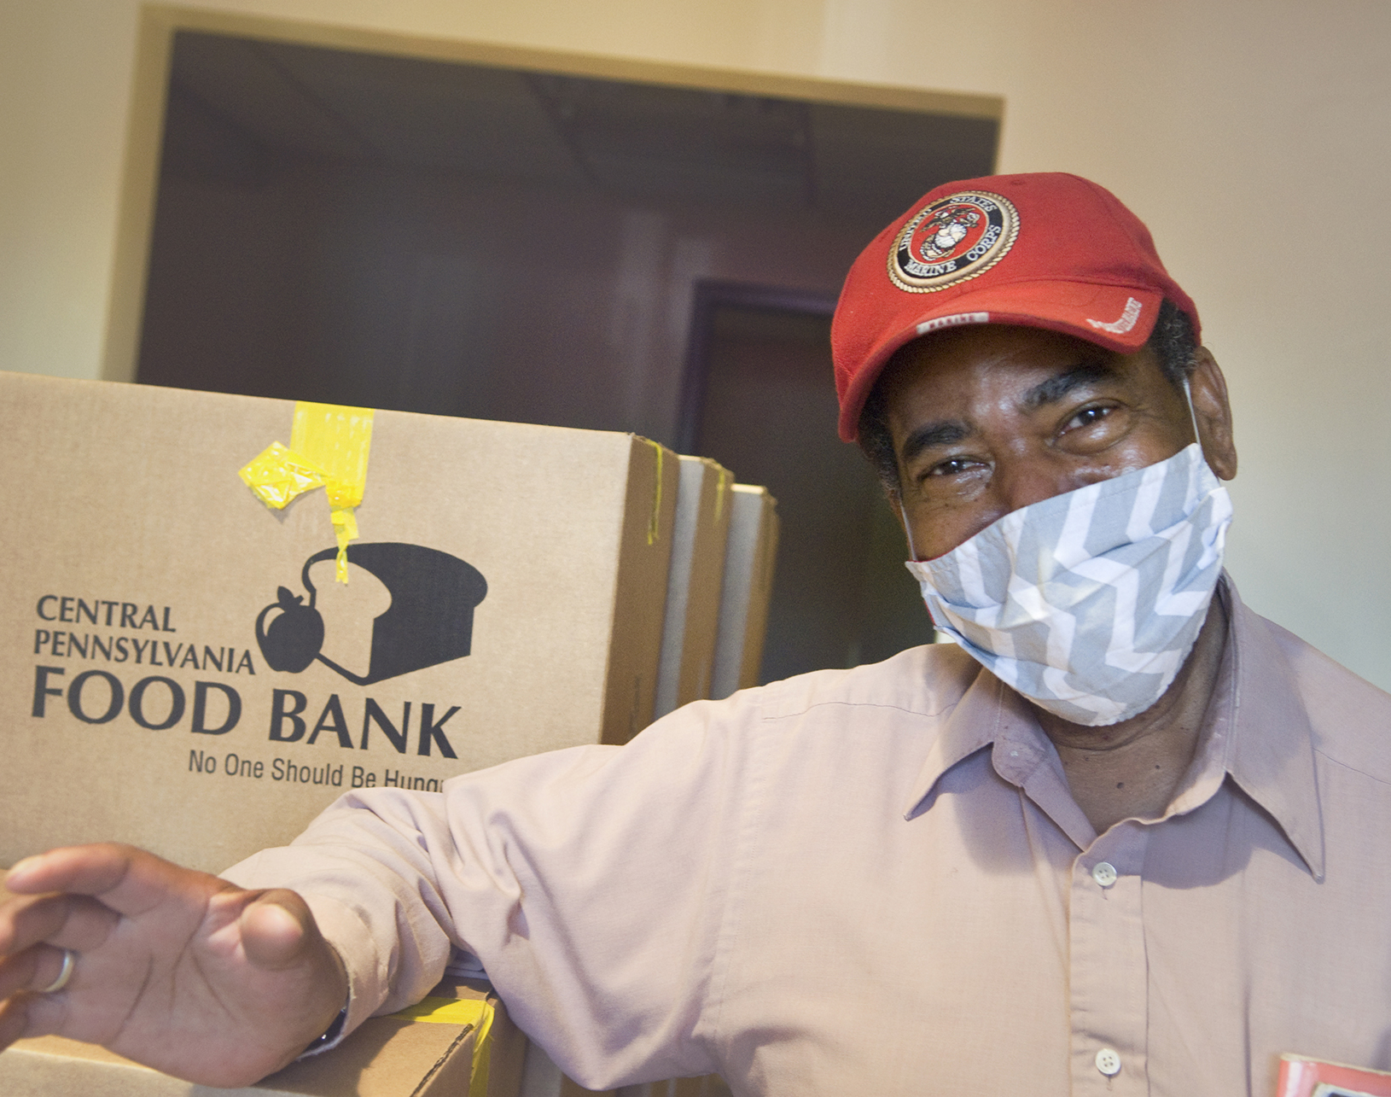
Improving Access to Fresh Food
Our Programs
Youth Programs
serving 190,000 kids and teens
Senior Programs
55,000 senior boxes distributed
MilitaryShare
served nearly 13,000 veterans and active-duty military members and their families
Health Innovations
SNAP Outreach
Through our Helpline, more than 2,500 families and individuals have been assisted in completing their SNAP application submissions.
www.centralpafoodbank.org
Notes:
We will then distribute the acquired fresh food through our various programs, providing fresh food year- round.
Youth programs – 29% of people we serve are children. We work with schools and nonprofits to reach young people throughout the year with our backpack, afterschool kids café, school pantries and summer programs.
Senior program – 13% of people we serve are seniors. The food provided is designed to enrich the diet of seniors. Seniors are often isolated and must make difficult decisions such as paying for food or paying for medications.
Military Share – Over 20% of households receiving food assistance have at least one member who has served, or is currently serving, in the military. Distributions take place at VFW’s and other military service organizations.
Health Innovations – Better Access to Better Foods = Better Health. The Central Pennsylvania Food Bank’s Health Innovations Program connects its emergency feeding network and consumers served by these programs with members of the medical community to promote health, wellness, and nutrition education.
SNAP Outreach - Without SNAP (Supplemental Nutrition Assistance Program), food banks could not reach all those in need and we encourage families to apply for this helpful federal program. We have a helpline to assist people in submitting the SNAP application so they can purchase nutritious food.
Client Stories:
The woman in the upper corner is Madeline from Centre County. Madeline’s story is all too familiar for many seniors; living on a fixed income, her social security isn’t enough to pay her bills and buy food, and although she is a SNAP recipient, she is still unable to buy the healthier, more expensive food at the grocery store. She turned to the Food Bank and our partner in her backyard, which she still can’t believe how amazing and healthy the food she receives is.
The man in the lower corner is Jerry, a veteran who takes part in our Health Innovations program with our partner River Valley Health and Dental in Lycoming County. The program has helped him create new eating habits to keep his diabetes under control. He loves trying new things and has learned how to cook produce from the recipes given, even squash, which he now loves.

Slide 10
Joe’s Journey – Finance to Feeding
Accounting, Finance, Community Banking
Many roles in leadership positions
Community Banks expect their leaders to engage in community organizations
My volunteer journey led me to Central Pennsylvania Food Bank
Joined the CPFB Board in 2000, appointed Finance Committee Chair 2002-2003, Board President 2004-2005 (I fell hard for this mission!)
Joined CPFB Management Team in 2008 as part of a succession plan
Almost 14 years later, I can safely say I rely daily on the skills and experience I developed during my financial career
My key point for you: this type of journey is less unusual now as non-profit boards increasingly recognize the need for leadership skills and financial acumen
www.centralpafoodbank.org
Notes:
From finance to feeding our neighbors in need – Joe’s story…

Slide 11
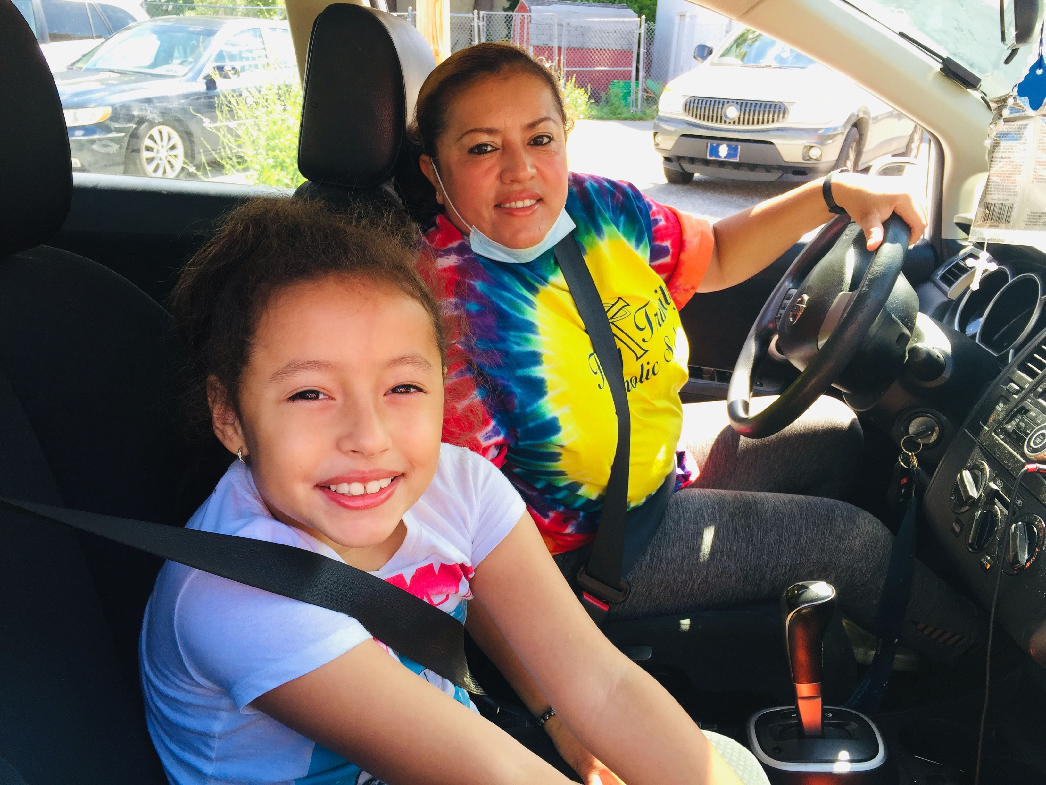
Together we
can end hunger
Volunteer
Last year, volunteers donated over 84,000 hours.
Donate
Every $1 donated helps us provide up to six meals
Participate in a fund (virtual) drive
Advocate
Together our voice can be mighty in representing those in need
www.centralpafoodbank.org
Notes:
We could not do this work without our community! Our network of local partner, our corporate food donors, our farmers, our financial donors, our volunteers, and friends!
Participate to Volunteer: Volunteers pack, sort food for expiration dates, and bag produce! Individual volunteers, companies, schools, clubs, churches, scouts, etc. volunteer 6 days a week, day and evening.
Donate: Donations allow us to continue this important work. Because of our corporate food donors, farmers, financial supporters and ability to purchase large quantities of food, we are able to provide as many as 6 meals with every $1 donated!
We can no longer take food from food drives and encourage everyone to try our new “virtual food drive” platform , which can be found on our website under Ways to Give.
Advocate: The Central Pennsylvania Food Bank advocates for policies that protect individuals and families from hunger. Help us build a powerful movement. Together, government, employers, communities, neighbors, and others can address the root causes of food insecurity to ensure that every family has access to adequate food and nutrition.
Pictured in this slide is Berta and Natalie. Any mother raising even one young child knows what it’s like to have her hands full. When Berta lost her job due to COVID money for her and her two children was tight. Now as they rebuild their lives, Berta still needs the helping hand to put food on her family’s table. Berta is grateful to the Food Bank and her local pantry for giving her an extra hand when she needs it most.

Slide 12
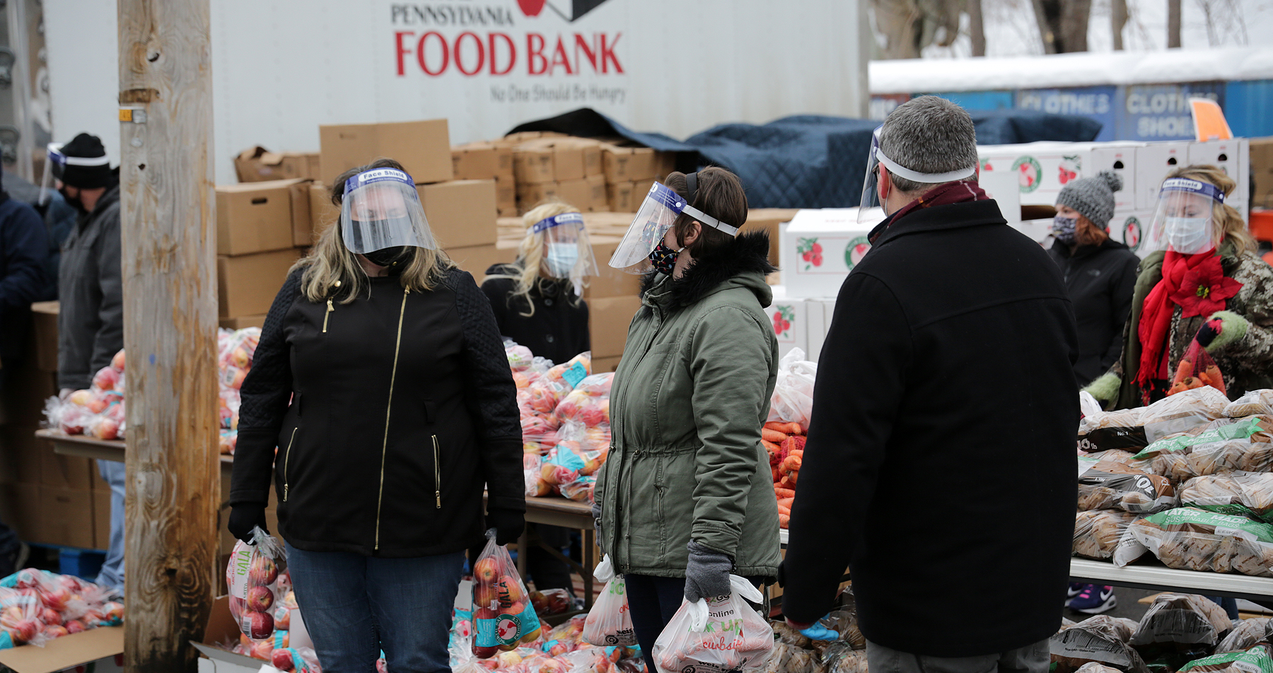
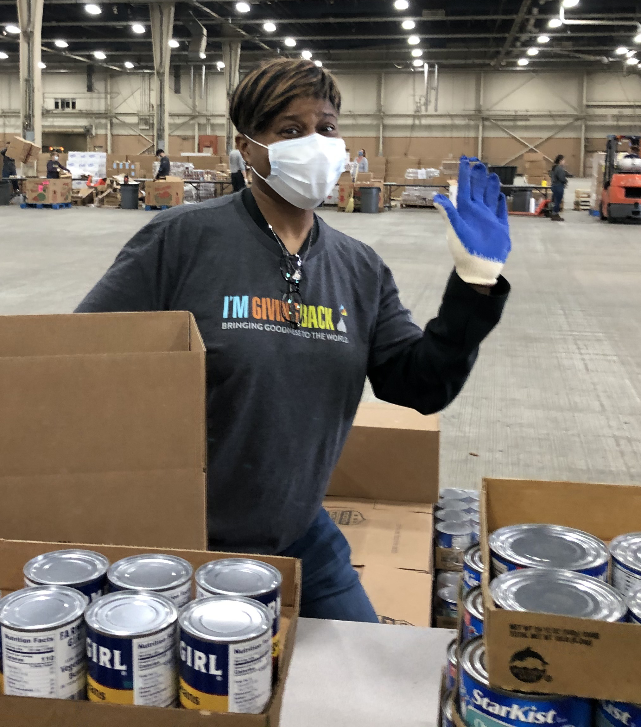
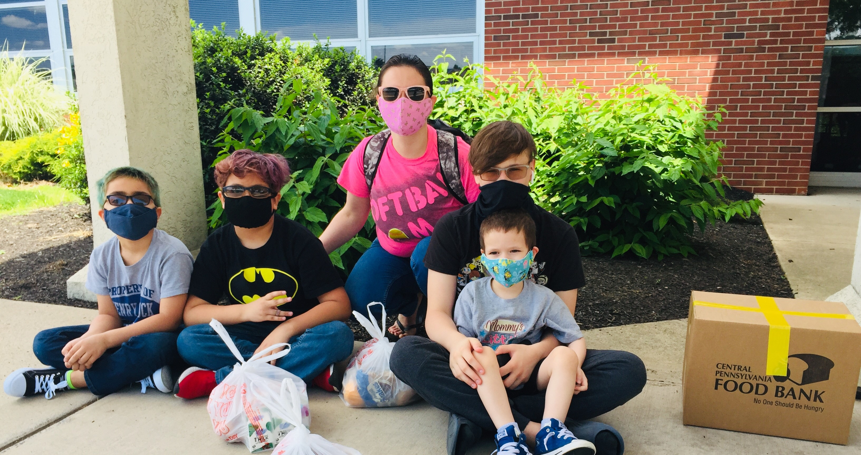
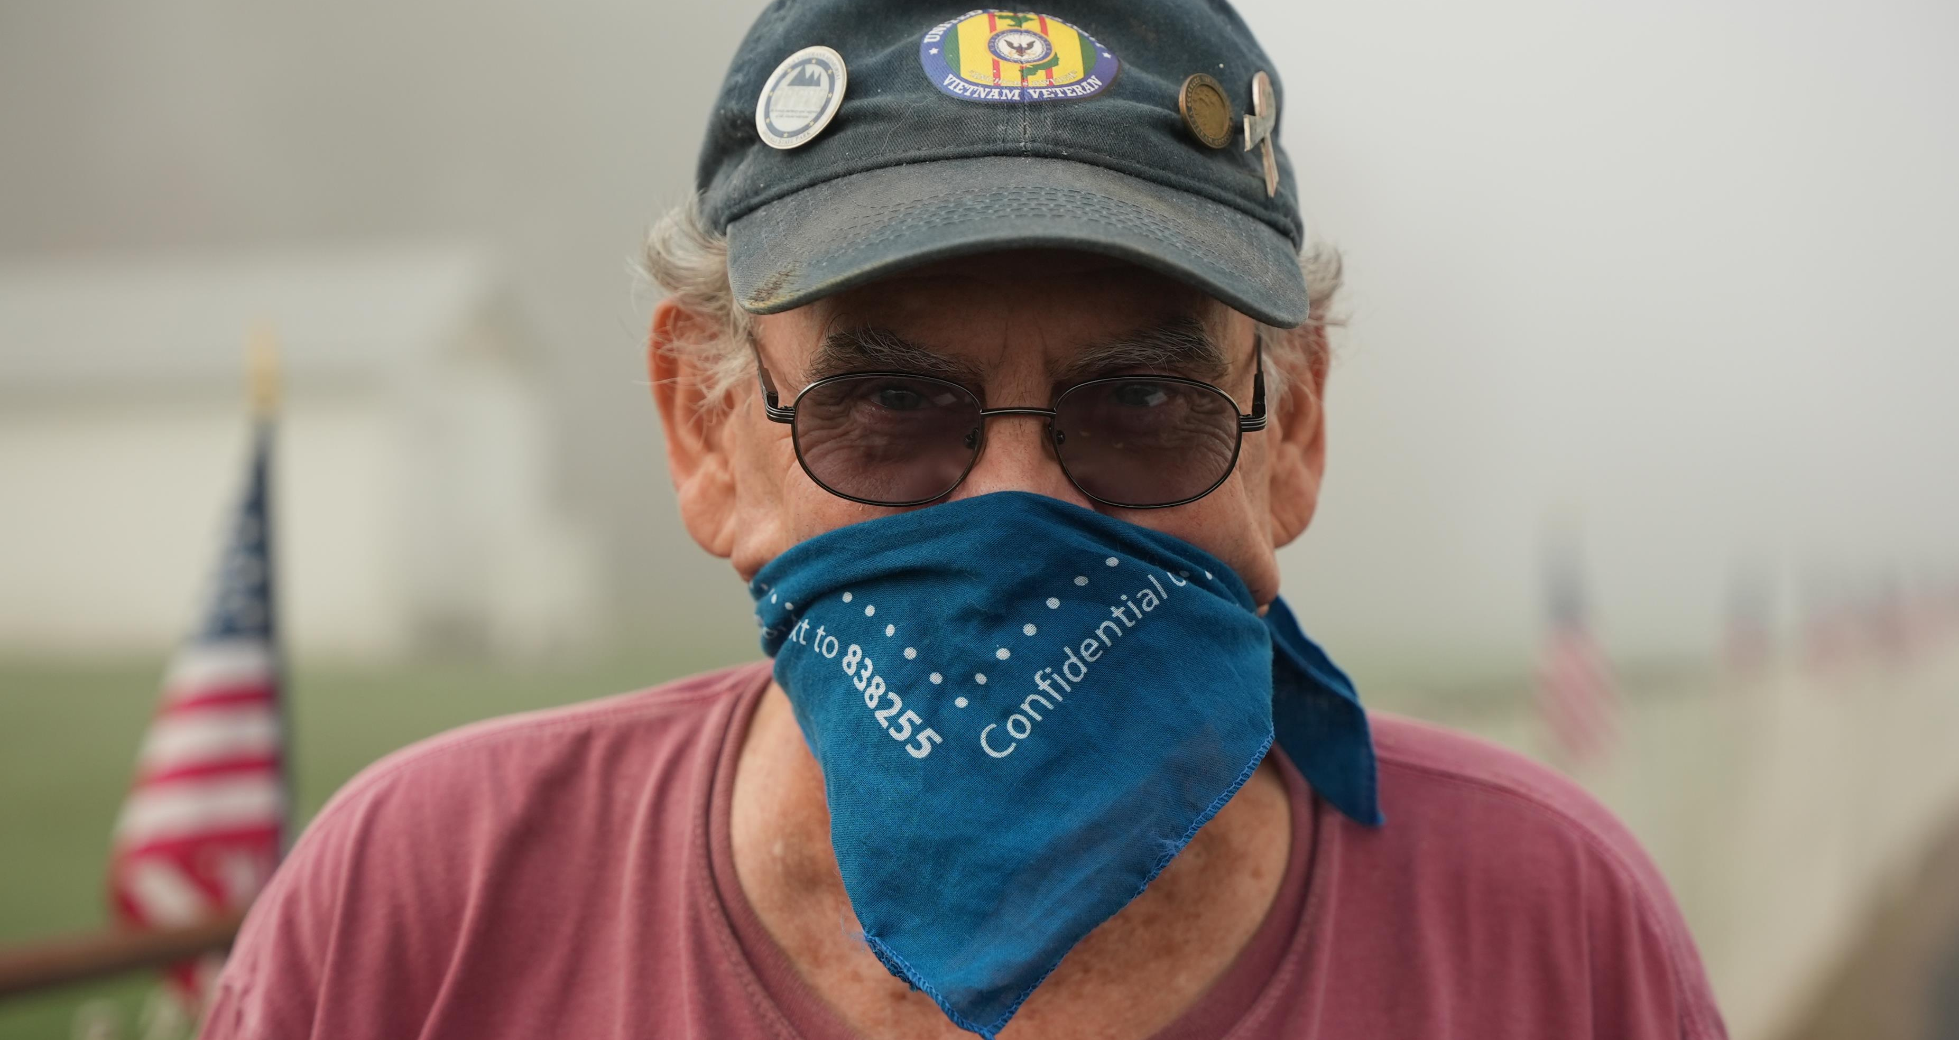
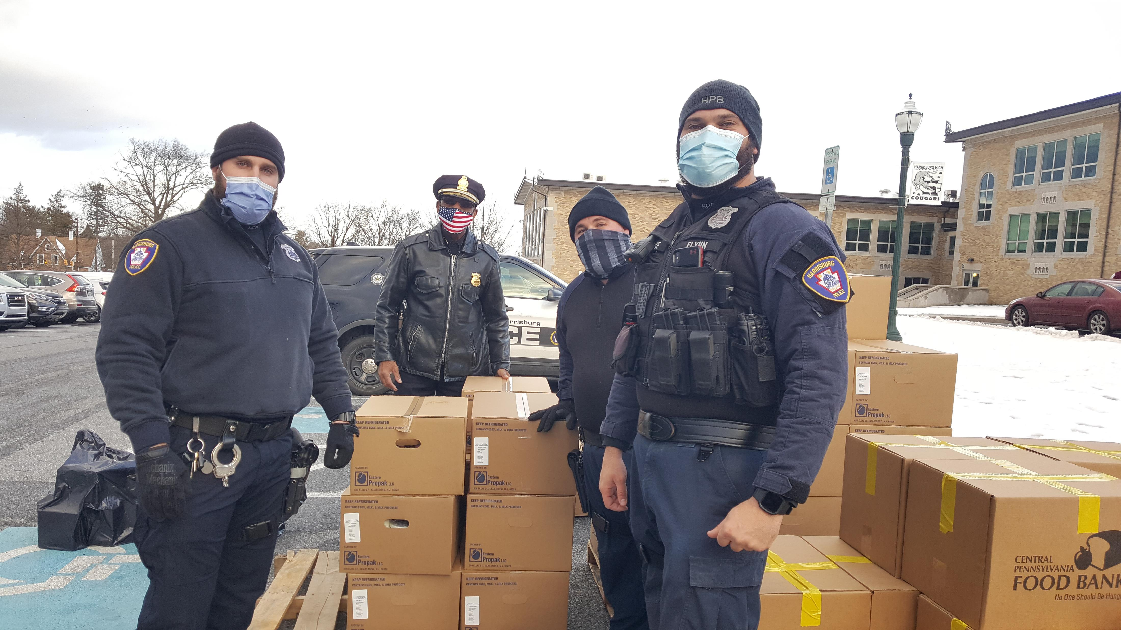
JOIN US in the fight to end hunger.
Notes:
Hunger isn’t selective – it can happen to anyone at anytime. Our community is better when we join hands and help end hunger together.
I would like to share one last video as we come to a close. (hyperlink on center volunteer image or skip if you are unable to play video. Feel free to use any video story from our YouTube channel to hyperlink.)
Stories like this are at the heart of our work.

Slide 13
Thank You!
Questions?
Name, Title
Phone number:
Email:
www.centralpafoodbank.org
Notes:
Thank you for your time and for your support! If you are interested in more information on how you can join in the fight to end hunger, please feel free to contact me or go to our website – centralpafoodbank.org.

Slide 14
WE’RE SOCIAL!
Join in the conversation and tag us.
www.centralpafoodbank.org
Notes:
By following us on our social channels and sharing out our content, you are helping spread awareness on the issues of hunger.

